Slide 1

Mega Mart (Shopping cart)
Team 2
By:
Amit kumar, Anirudh Aggarwal, Hritik Kumar, Prayati Paliwal, Rishikant Kumar, Rohit Mohan

Slide 2

Introduction
A simple, user-friendly e-commerce solution for businesses.
Offers seamless online shopping and order management for customers.
For consumers, the website provides an enjoyable shopping experience with quick navigation and easy checkout.

Slide 3
Vision : To be the leading shopping cart platform globally, revolutionizing online shopping for both consumers and businesses through innovation, convenience, and cutting-edge technology.
01
Mission : To empower businesses and enhance the customer shopping experience by delivering a reliable, secure, and seamless shopping cart solution.
02
Purpose : Enable consumers to shop conveniently from anywhere, anytime, while offering a wide variety of products and services.
03

Slide 4
Objectives
Enhance E-commerce Accessibility
Improve User Experience
Ensure Scalability
Maximize Customer Retention

Slide 5

Technologies & Tools
Html
CSS
JavaScript
Docker
VsCode

Slide 6
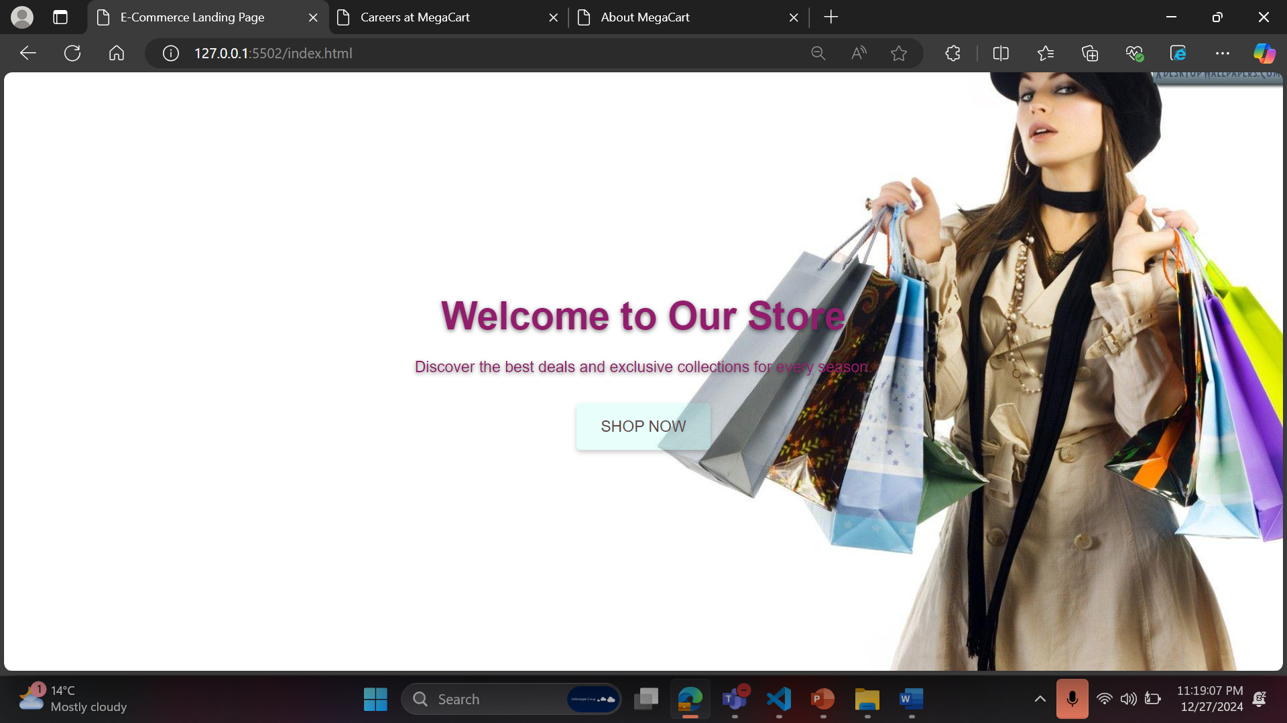

Slide 7
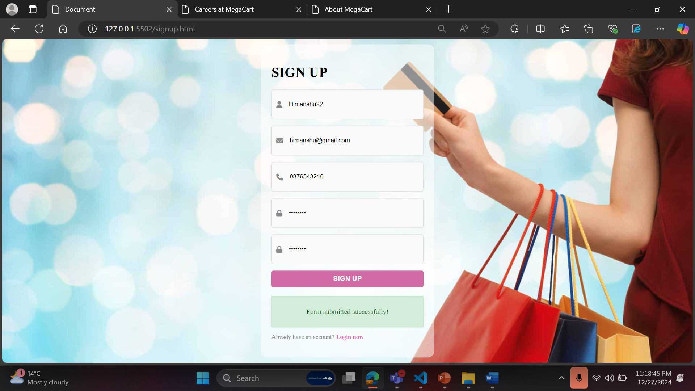

Slide 8
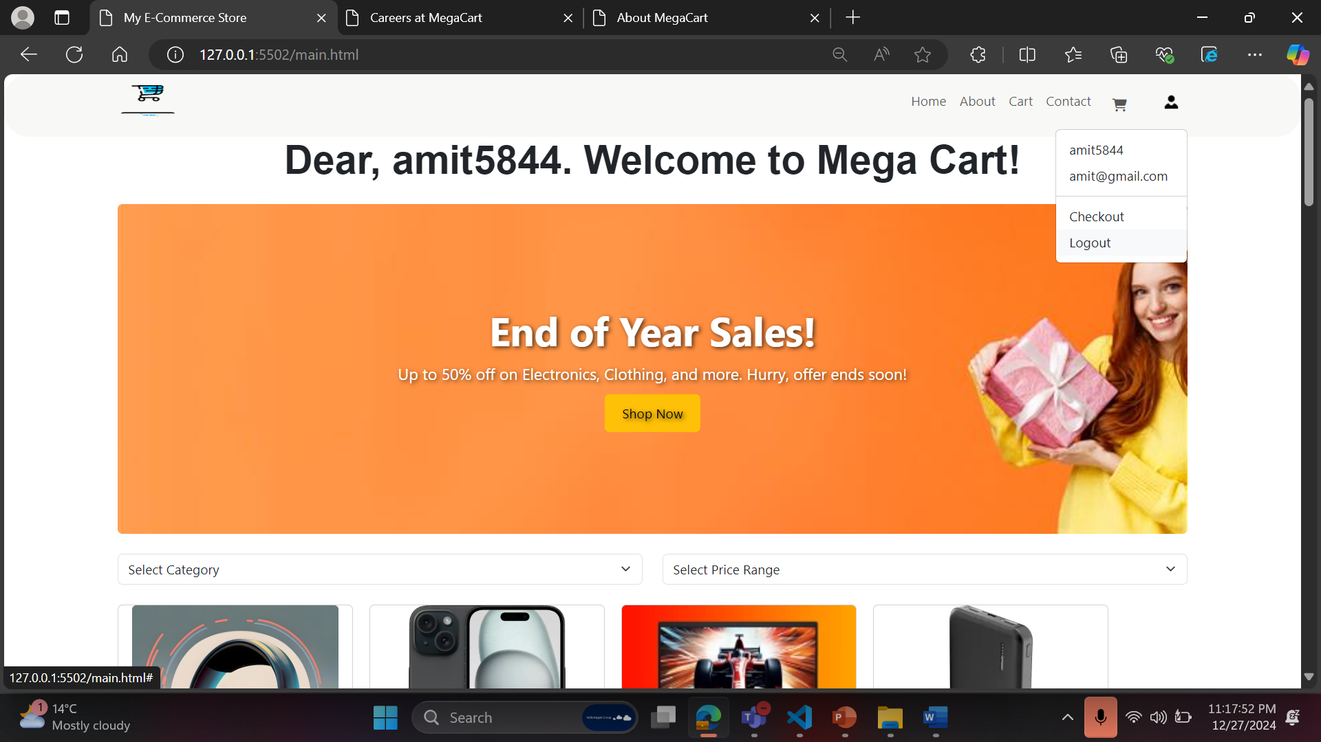

Slide 9
Docker Image Creation
Ensuring Docker is Installed and Running:
docker –version
Build the Docker Image:
docker build -t megacart .
Manual repository creation on Docker Hub
Tag the Docker Image:
docker tag megacart hrithik30/megacart:latest
Push the image:
docker push hrithik30/megacart:latest
Run the Docker Container Locally:
docker run -d -p 8080:80 megacart

Slide 10
Docker Image Creation
List Docker Images :
docker images
List Running Containers
docker ps

Slide 11
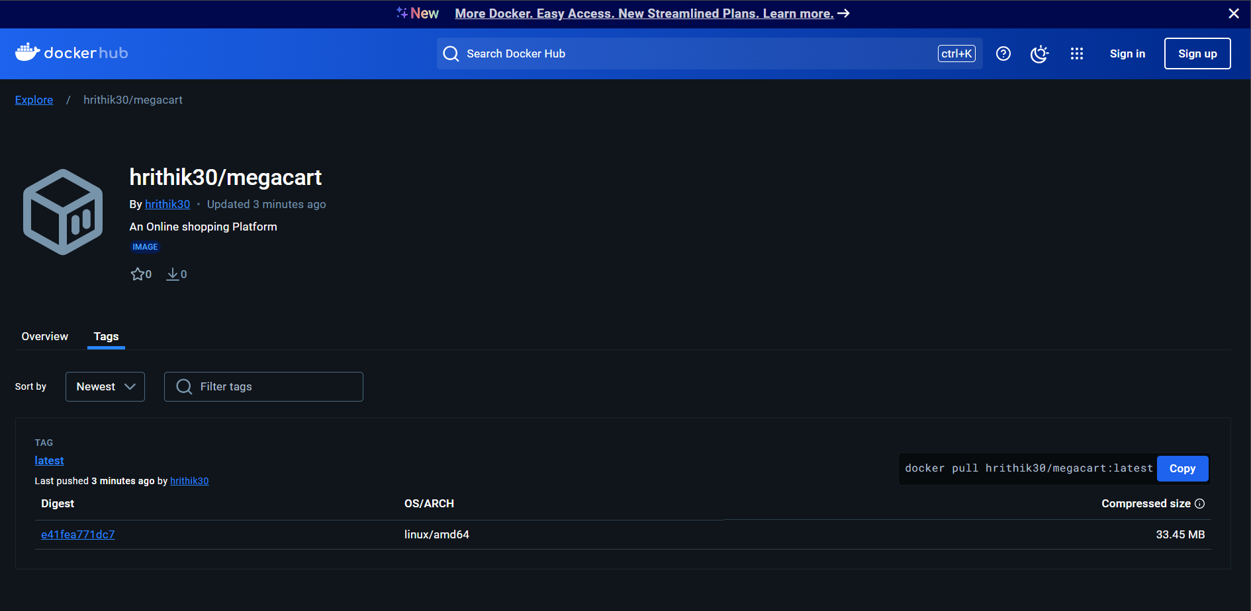

Slide 12

Future Scope
User Authentication
Wishlist Functionality
Basic Analytics
Data Management
Backend Development
Payment Integration

Slide 13

Conclusion
Our shopping cart platform is built to help businesses grow by providing a seamless, secure, and intuitive shopping experience.
With a focus on innovation and customer satisfaction, we strive to create lasting relationships with our users and help them thrive in the digital marketplace.

Slide 14

Thank You

